Slide 1
Max Flows:
Polynomial Algorithm
CONTENTS:
Application of Max-Flow Min-Cut Theorem
Shortest Augmenting Path Algorithm
Capacity Scaling Algorithm
READING ASSIGNMENTS:
Chap 7.1~7.5
Notes:
Obtain a network, and use the same network to illustrate the shortest path problem for communication networks, the max flow problem, the minimum cost flow problem, and the multicommodity flow problem. This will be a very efficient way of introducing the four problems. (Perhaps under 10 minutes of class time.)

Slide 2
Network Reliability
Communication Network
What is the maximum number of arc disjoint paths from s to t?
  How can we determine this number?
Theorem. Let G = (N,A) be a directed graph. Then the maximum number of arc-disjoint paths from s to t is equal to the minimum number of arcs upon whose deletion there is no directed s-t path.
s
t

Slide 3
There are 3 arc-disjoint s-t paths
1
5
9
2
6
10
s
t
3
7
11
4
8
12
Notes:
Introduce myself and the Tas.
It is critical that students sign up for the virtual campus web site. Hand out instructions on how to use it. Make sure that everyone signs up on the list.
Also, create a class list that is separate from the web site.
Ask for a show of where students come from. There should be four major contingencies:
Grad EECS, ORC, Transportation, Rest

Slide 4
Deleting 3 arcs disconnects s and t
Let S = {s, 3, 4, 8}. The only arcs from S to
T = N\S are the 3 deleted arcs.
1
5
9
2
6
10
s
t
3
7
11
4
8
12
Notes:
Introduce myself and the Tas.
It is critical that students sign up for the virtual campus web site. Hand out instructions on how to use it. Make sure that everyone signs up on the list.
Also, create a class list that is separate from the web site.
Ask for a show of where students come from. There should be four major contingencies:
Grad EECS, ORC, Transportation, Rest

Slide 5
Node disjoint paths
Two s-t paths P and P' are said to be node-disjoint if the only nodes in common to P and P' are s and t.
How can one determine the maximum number of node disjoint s-t paths?
Answer: node splitting
Theorem. Let G = (N,A) be a network with no arc from s to t. The maximum number of node-disjoint paths from s to t equals the minimum number of nodes whose removal from G disconnects all paths from nodes s to node t.

Slide 6
There are 2 node disjoint s-t paths.
1
5
9
2
6
10
s
t
3
7
11
4
8
12

Slide 7
Deleting 5 and 6 disconnects t from s?
Let S = {s, 1, 2, 3, 4, 8}
There is no arc directed from S to T.
Let T = {7, 9, 10, 11, 12, t}
1
5
9
2
6
10
s
t
3
7
11
4
8
12

Slide 8
Matchings
An undirected network
G = (N, A) is bipartite if N can be partitioned into N₁ and N₂ so that for every arc (i,j) either i ∈ N₁ and j ∈ N₂.
1
6
2
7
A matching in N is a set of arcs no two of which are incident to a common node.
3
8
4
9
Matching Problem: Find a matching of maximum cardinality
5
10

Slide 9
Transformation to a Max Flow Problem
1
6
2
7
s
3
8
t
4
9
Replace original arcs by pairs, and put infinite capacity on original arcs.
5
10
Each arc (s, i) has a capacity of 1.
Each arc (j, t) has a capacity of 1.

Slide 10
Find a max flow
1
6
2
7
s
3
8
t
4
9
5
10
The maximum s-t flow is 4.
The max matching has cardinality 4.

Slide 11
Determine the minimum cut
1
1
6
6
2
7
s
s
3
3
8
8
t
4
4
9
5
10
S = {s, 1, 3, 4, 6, 8}. T = {2, 5, 7, 9, 10, t}.
There is no arc from {1, 3, 4} to {7, 9, 10} or from {6, 8} to {2, 5}. Any such arc would have an infinite capacity.

Slide 12
Interpret the minimum cut
1
1
6
6
6
2
2
7
s
s
s
s
3
3
8
8
8
t
t
4
4
9
5
5
10
Look at the original nodes incident to the minimum cut. Every original arc is incident to one of them.

Slide 13
Matching Duality 1
1
1
6
6
6
2
2
7
Such a collection of nodes is called a node cover
3
3
8
8
8
4
4
9
5
5
10
The maximum cardinality of a matching is the minimum number of nodes that “covers” all of the arcs.

Slide 14
Matching Duality 2
1
1
1
6
6
6
Consider a matching problem without a “complete matching.”
6
Let T = nodes on the right in the node cover.={6,8}
2
2
7
Claim: |S| > |T| and the nodes in S are adjacent only to nodes in T.
3
8
3
3
8
8
8
Let S = nodes on the left not in the node cover.={1,3,4}
4
4
4
9
5
5
10
Theorem. Hall’s Theorem. If there is no perfect matching, then there is a set S of nodes of N₁ such that |S| > |T| where T are the nodes of N₂ adjacent to S.

Slide 15
Review of the Ford-Fulkerson Algorithm
Begin
  x := 0;
  create the residual network G(x);
  while there is some directed path from s to t in G(x) do
  begin
    let P be a path from s to t in G(x);
    δ* := δ(P);
    send δ* units of flow along P;
    update the r's;
  end
end {the flow x is now maximum}.

Slide 16
Improved Algorithms
The largest augmenting path algorithm:
  Let P be a path from s to t in G(x) such that δ*` is maximum.
The shortest augmenting path algorithm:
  Let P be a path from s to t in G(x) with the fewest number of arcs.

Slide 17
The Shortest Augmenting Path Algorithm
Overview:
We will establish the following:
  We can determine each augmentation in O(n) time if we maintain "distance labels" and can carry out the augmentation in O(n) time.
  The total time to maintain and update all distance labels is O(nm).
  The total number of augmentations is O(nm).
Conclusion. The total running time is O(n²m).

Slide 18
Distance Labels
A distance label is a function d: N → Z⁺. A distance label is said to be valid if it satisfies the following:
    d(t) = 0.
    d(i) ≤ d(j) + 1 for each (i,j) ∈ G(x).
An arc (i,j) ∈ G(x) is admissible if d(i) =d(j) + 1.

Slide 19
An example of valid distance labels
capacity
The distance labels are on the nodes.
4
2
1
5
1
3
1
1
1
All arcs are in the residual network.
4
2
4
s
2
4
1
t
0
t
3
2
1
The admissible arcs are thick and red.
3
1
The labels would not be valid if there were an arc from “2” to “0”.

Slide 20
More on valid distance labels
Lemma. Let d( ) be a valid distance label. Then d(i) is a lower bound on the distance from i to t in the residual network. (The distance is measured in terms of the number of arcs.)
Proof. Let P be any path from i to t in G(x) with k arcs. We claim to show that d(i) ≤ k. Assume the claim is true for paths of k-1 or fewer arcs.
P has k arcs
≤ k
≤ k-1
0
i
j
t
P’ has k-1 arcs

Slide 21
On Finding shortest s-t paths
Lemma. If there is an admissible path P from s to t, then it is a shortest path.
Proof. The length of the path is d(s) which is at most the length of the shortest path.
4
3
2
1
0
s
t

Slide 22
The shortest augmenting path algorithm
begin
  while d(s) < n do
  begin
    if there is a node with d(i) ≤ d(s) and no admissible arcs from i then Relabel(i)
    else find an admissible path from s to t and augment flow along the path
  end
end
Procedure Relabel(i)
begin
  if there are no admissible arcs coming out of node i, then
  d(i) := 1 + min ( d(j) : r_{ij} > 0};
  if d(s) > n-1, then quit;
end
Shortest augmenting path

Slide 23
Comments on the run time analysis
Bound the relabels, and the time for relabels
  O(n²) relabels, O(nm) time.
Bound the number of augmentations, and the time to carry out the augmentations
  O(nm) augmentations
  O(n²m) arcs in augmentations
  O(n²m) time.
Bound the time spent looking for augmentations.
  O(n²m) time spent identifying the arcs in augmentations.

Slide 24
Bounding the number of relabels.
Claim: after a relabel of node i, the distances are still valid, and the distance label of node i strictly increased.
Claim: Once d(i) > n-1, there is no path from node i to the sink node t, and so one can ignore node i subsequently.
Conclusion: There can be at most n relabels of node i, and at most n² relabels in total.

Slide 25
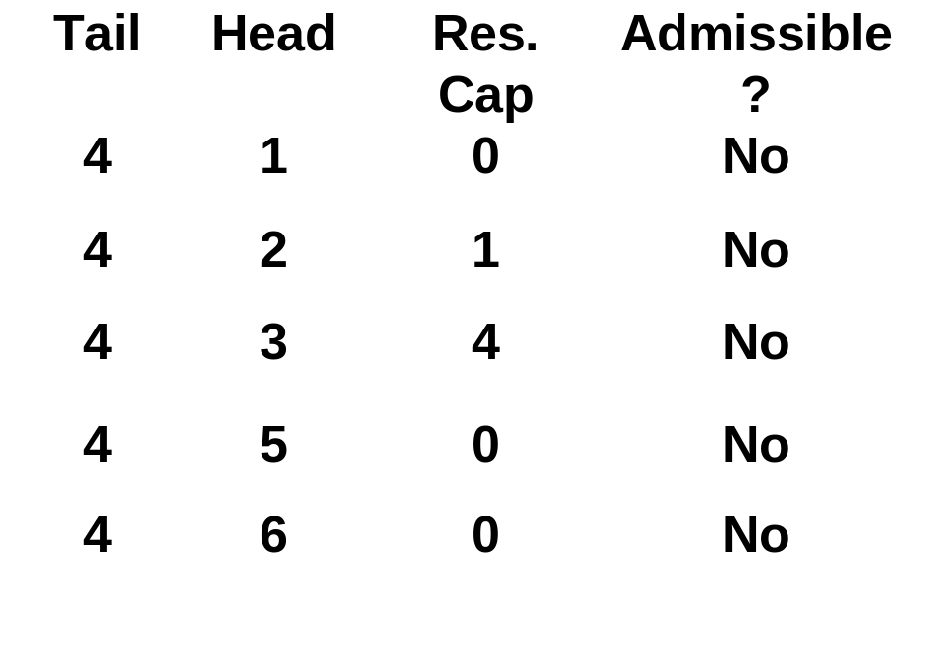
Bounding the time for relabels
Maintain a current arc for each adjacency list.
Scan through A(4).
d(3) := 4
1
3
Each arc in A(4) is scanned once per relabel, at most n times over all relabels.
1
2
3
4
3
4
Total time for relabels:
O(nm).
6
2
5
2

Slide 26
Bounding the Number of Augmentations
If an augmentation uses up the residual capacity of an arc, then the arc is said to be saturated.
At least one arc is saturated at each augmentation.
If arc (i,j) is saturated, then it is not admissible until flow is sent from j to i, and this cannot happen until d(j) increases. (see next slide)
Conclusion: each arc is saturated at most n times.
Corollary. There are O(nm) augmentations.
The number of arcs in these augmentations is O(n²m).

Slide 27
(2,1) is saturated in the augmentation
3
3
2
2
2
3
5
1
1
2
1
2
1
1
1
1
4
2
2
s
2
2
3
3
4
1
1
t
0
0
2
1
1
2
2
3
1
1
2
2
After the saturation, arc (2,1) is deleted from G(x).
It doesn’t get added until there is flow in (1,2)
But for that, the distance label must increase from 1 to 3.
And to send flow back, the distance label must increase from 2 to 4.

Slide 28
Time spent looking for augmentations
We need to find admissible arcs, and know when they do not exist.
2
2
5
1
3
1
1
1
4
2
2
s
2
2
4
1
t
0
2
1
1
2
2
3
1
1
Start with s and do a depth first search using admissible arcs.
If there are no admissible arcs from i, then relabel(i) and reverse along the path leading to i.

Slide 29
Bounding number of arcs in paths
Each arc added to a path either ends up being reversed or ends up in an augmentation.
O(n²m) arcs in augmentation
O(n²) arcs in reversals, since a reversal immediately follows a relabel.
O(n²m) arcs added to paths in total.

Slide 30
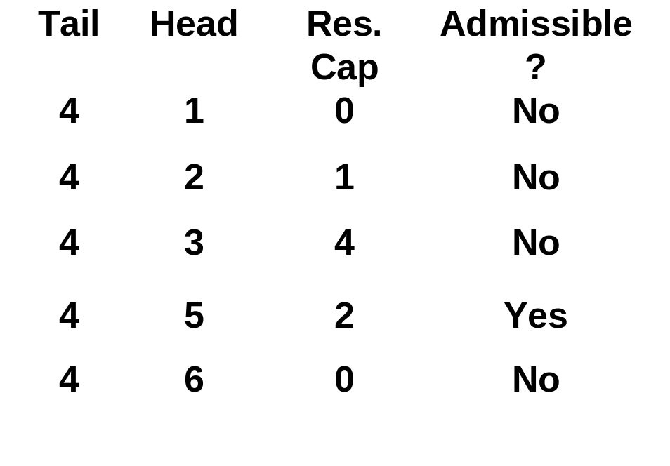
Last step: finding admissible arcs
Scan arcs in A(4) looking for an admissible arc.
key observation: if (4, j) is not admissible, it cannot be admissible again until after node 4 is relabeled.
1
3
1
2
3
4
3
4
So, current arc is moved at most |A(4)| times between relabels of node 4.
6
2
5
2

Slide 31
Summary
Applications of Maximum Flow, including implications of the max flow min cut theorem.
The shortest augmenting path algorithm has O(nm) augmentations, and takes O(n²m) time.
Use of distance labels to identify how to send flow.
Next lecture: an algorithm that does not rely on augmenting paths.

Slide 32
The Capacity Scaling Algorithm
For any fixed value Δ, let G(x,Δ) be the arcs in G(x) with capacity at least Δ.
A flow x is called Δ-maximum if there is no augmenting path of size Δ or more.
Subroutine ImproveApprox(x,Δ). It takes a flow that is Δ-maximum and outputs a flow that is Δ/2-maximum.
ImproveApprox(x,Δ)
begin
  Δ := Δ/2;
  while there is a path from s to t in G(x,Δ) do
  begin
    find a path P from s to t in G(x,Δ);
    augment flow along P;
    update data structures;
  end
end

Slide 33
When is there a feasible flow?
6
-3
-1
4
-3
-3
Suppose all arcs have a capacity of 2, and that node numbers are supplies/demands. Then there is no feasible flow.

Slide 34
Infeasibility Theorem
6
6
-3
Supply of S is 7
-1
4
4
-3
-3
-3
Infeasibility Theorem. Either there is a feasible flow, or there is a cut (S, T) such that:
the capacity of (S, T) < supply of S

Slide 35
Infeasibility Theorem
6
6
-3
-1
4
4
-3
-3
-3
Supply of S is 7.
The capacity of (S, N\S) = 6.

Slide 36
More on Capacity Scaling
This is the residual network at the end of the scaling phase when Δ = 10.
8
4
5
10
10
4
5
20
s
1
2
25
5
7
t
9
15
5
30
6
3
6
How many augmentations can there be from s to t when Δ is reduced from 10 to 5?

Slide 37
Analysis of Capacity Scaling
There are O(log U) scaling phases.
Initially Δ is at most 2U.
 Δ is halved at each scaling phase
We can stop when Δ is 1.
The running time per scaling phase is O(m²).
Each scaling phase has O(m) augmentations.
The time per augmentation is O(m).
The total running time is O(m² log U)

